Slide 1
How better tech could protect us from distraction
-Tayyab L. Tamboli

Slide 2
What does it mean to spend our time well?

Slide 3
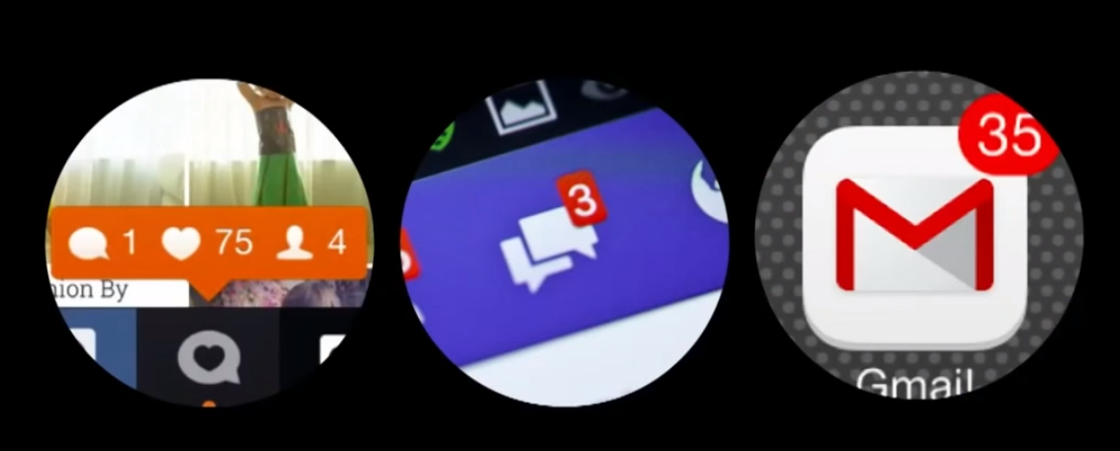

Slide 4
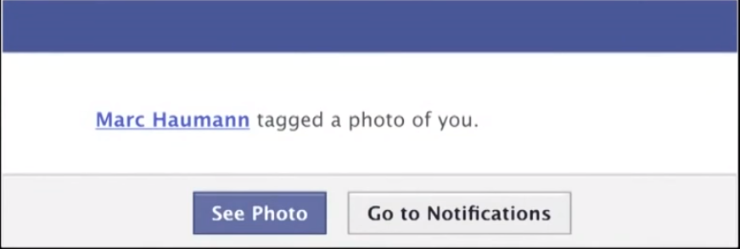
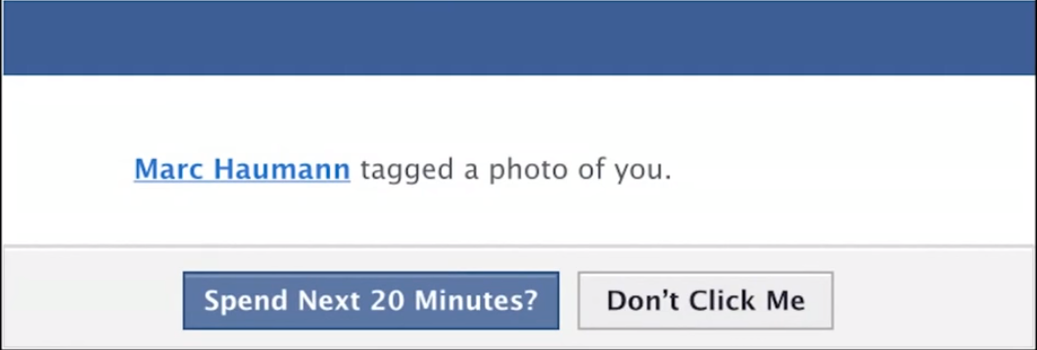

Slide 5
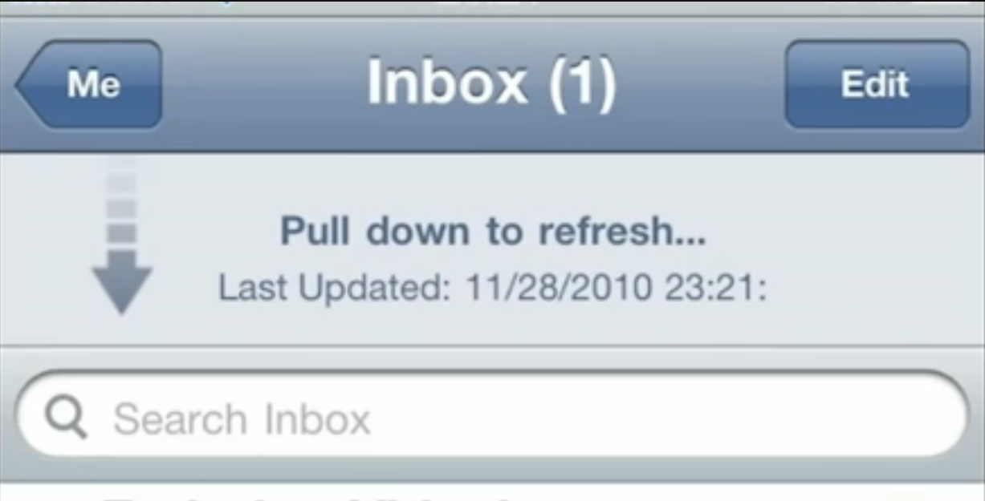
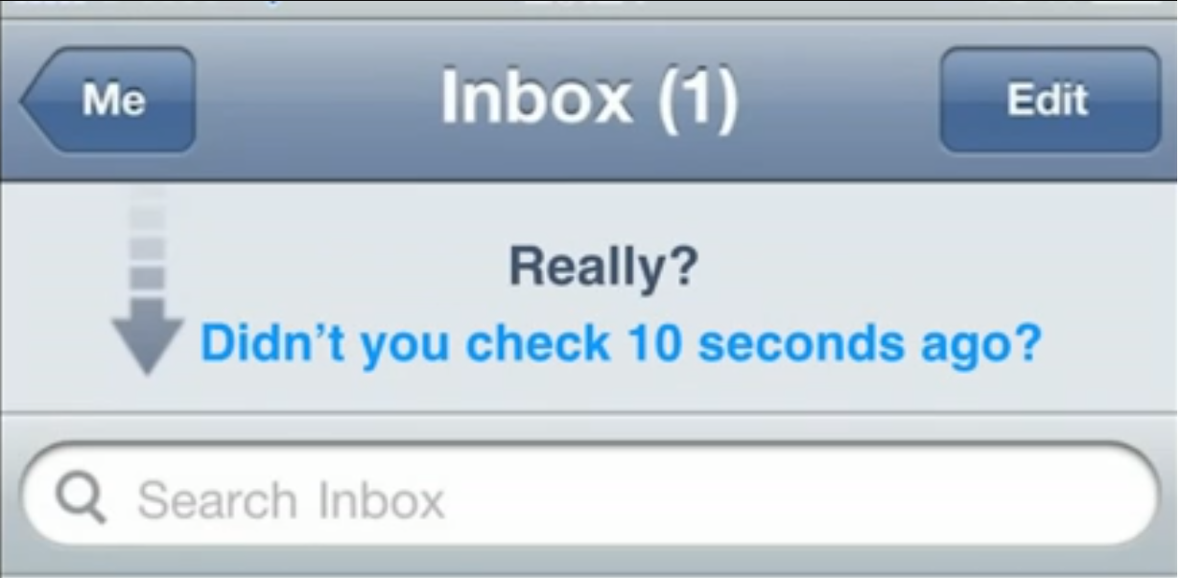

Slide 6
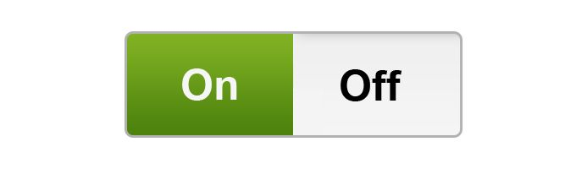
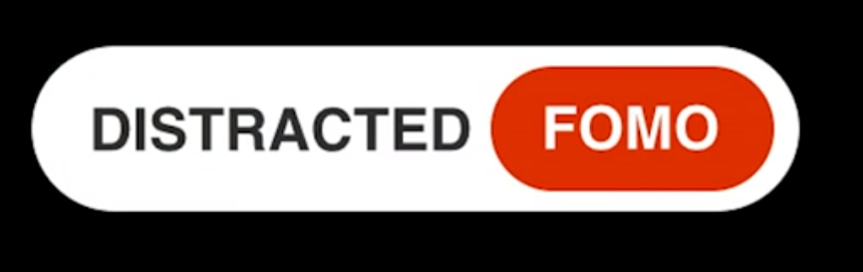

Slide 7
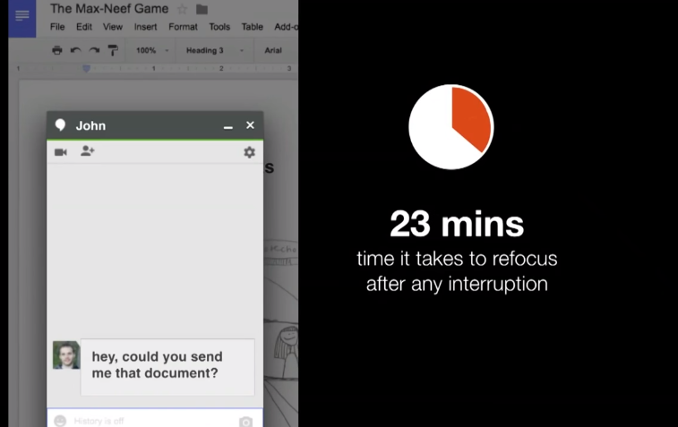

Slide 8
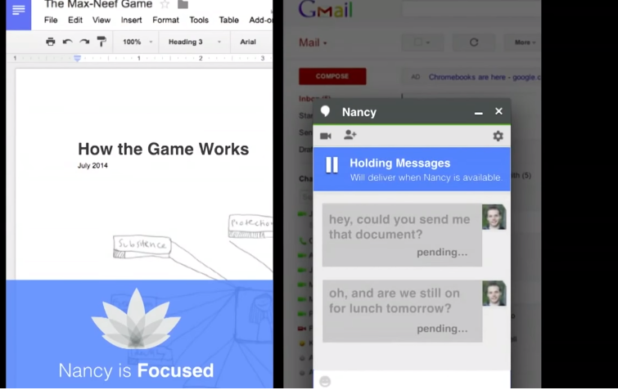

Slide 9
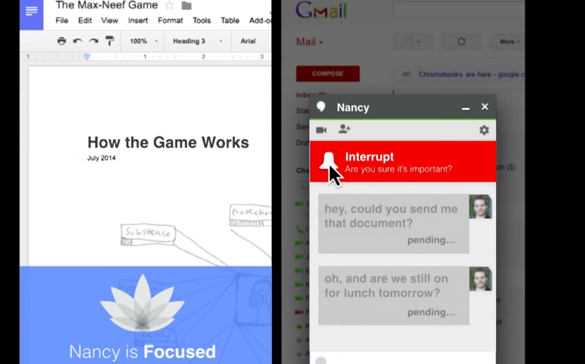

Slide 10
Previous design goal:
Send message quickly and easily.
Human design goal:
High-quality communication and relationship.

Slide 11
We can create this world today!
Company leaders – Prioritize new matric
Designer – Redefine the design
Users – Demand technology that work this way

Slide 12
Time
spent
Time
well
spent

Slide 13
THANK YOU!!

